Slide 1



Azure Applications Management

Slide 2

Developer Support meets you where you are in the development lifecycle and leads your software engineers to achieve more.

Slide 3
Developer Support focus areas
Solutions for key business priorities
DEVOPS
APP SECURITY
APP MODERNIZATION
AI & IoT
Accelerate software delivery using DevOps practices
Reinforce your application security to protect your brand, customers, and employees
Strategically integrate the latest technology into your app portfolio
Elevate competitive advantage, improve efficiency, and boost business potential
Automate your delivery and testing processes to increase engineering efficiency and service reliability
Assess and remediate application threats and optimize SDL and secure DevOps processes using modern security tools and services
Modernize applications and processes using cloud services such as containers and microservice
Enhance your app portfolio by learning to build intelligent chatbots and infuse AI into apps and processes​
Expert training and implementation guidance throughout your Developer Support engagement to sustain app architecture, AI integration, app security, and DevOps processes

Slide 4


Developer Support: Azure Applications Management
Integrate Azure Applications Management into the DNA of your organization
YOUR NEEDS
HOW WE CAN HELP
Azure is made of subscriptions, resource groups, resources
Enterprise IT is made of departments, users, roles, development teams, projects, environments, costs
Bigger is the enterprise more is made also of on-premise assets and mashup of services on many public clouds
To have a unified and handy view of all IT assets and his connections, costs, point of contacts, managers
“One-stop-shop” for all your enterprise assets
Implementation guidance to map resources to financial hierarchies including re-organizations.
Search powered interface integrated with Azure Portal and integrable with other 3rd party tools
Applications Management optimization best practices based on the Microsoft internal experience and the experience of Enterprise Services with hundreds of customers.
Lorem ipsut dixit amen

Slide 5
Detailed engagement structure
Scoping
Workshops
Deep-dive chalk talks (Optional)
Initial Implementation
Adding workloads and complexity
Scoping
& Capabilities Assessment
Modern Service Management – Cost Showback (People and Process)
Billing, Consumption and Usage APIs
Azure Assets Mapping
Support to drive cost as an architecture fitness function
4-8 hours
4 hours
Tagging and finance mapping design guidance
20+ hours
4-6 hours
5 days
Resource Tagging
Continuous assistance for cost optimization
Azure Management and Cost Optimization (Technology)
2 hour
4-16 hours
Azure Policy
Reporting templates implementation guidance
20+ hours
2 days
4 hour
Adding additional workloads to the process
8-40 hours
Azure Policy &
Automation implementation guidance
20+ hours
8-32 hours
Cost management portal implementation
Preview
1-2 days
Managed by an ADM
Notes:
The final scope is defined as part of the scoping engagement and depends on customer needs, environment size and existing capabilities.
Important to speak about the people aspect, asset management and the need to have a lead for this activity.
All the phases will be done in 1 quarter and additional iterations are possible to add more workload and continuously improve the system
The portal is great for customers that want to reach maximum maturity and need features that don’t exist in the Azure Cost Management tools

Slide 6







Corelations
subscription
AAD User
in subscription
in group
access
to
resource group
in resource group
has
AAD Group
Tags
resource
AAD enterprise application

Slide 7


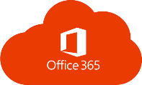









Architecture
Cognitive Services
SPA front-end
End User
Azure API
Cognitive Search
Azure Function
Cosmos DB
API
enterprise Apps
Bot
API directory
Intranet
LOB app

Slide 8
Demo

Slide 9
Cost management portal capabilities
Advanced cost analysis and extendable optimization recommendations engine
Monthly cost forecast based on the current consumption trends
Budget management at the business unit and application level
Alerts for visibility and timely actions

Slide 10
Sample one-year journey
Q1
Q2
Q3
Q4
Application Development Manager (ADM) coordinates the Service Delivery Plan
Ongoing architecture and cost optimization reviews
Hands on assistance adding workloads to the new process
Workshops
Initial implementation
Process and tools fine tuning
Add additional workloads

Slide 11
Next steps
Coordinate scoping and capabilities assessment
Generate and review Service Delivery Plan
Coordinate and deliver the services

Slide 12

Part of the Enhanced Solutions in Support
Enhanced Outcomes. Enhanced Solutions.

Slide 13
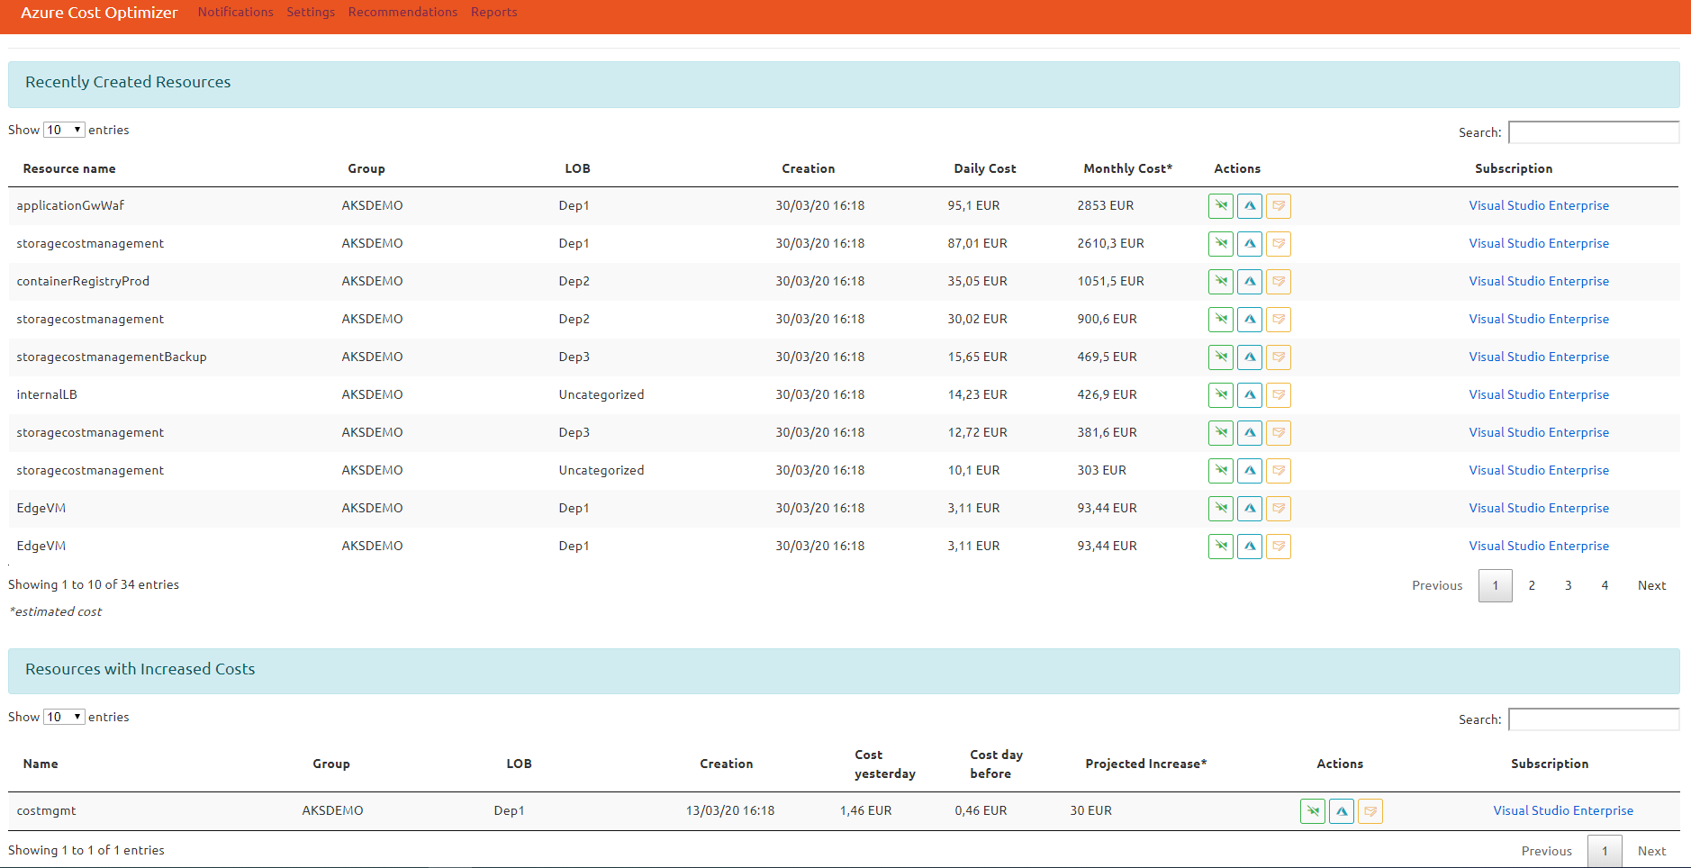
Notifications
Azure portal resource link
Notify Line Of Business owner
Resources with cost increase in the last 48 hours

Slide 14
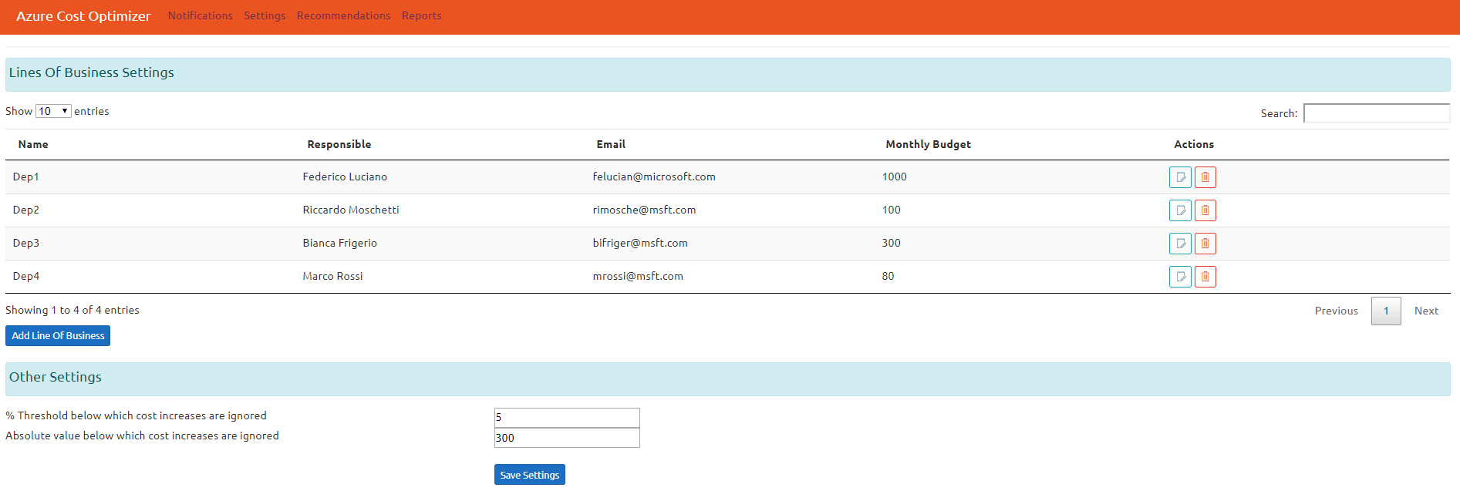
Settings
Edit Line Of Business
Delete Line Of Business
Alert treshholds

Slide 15
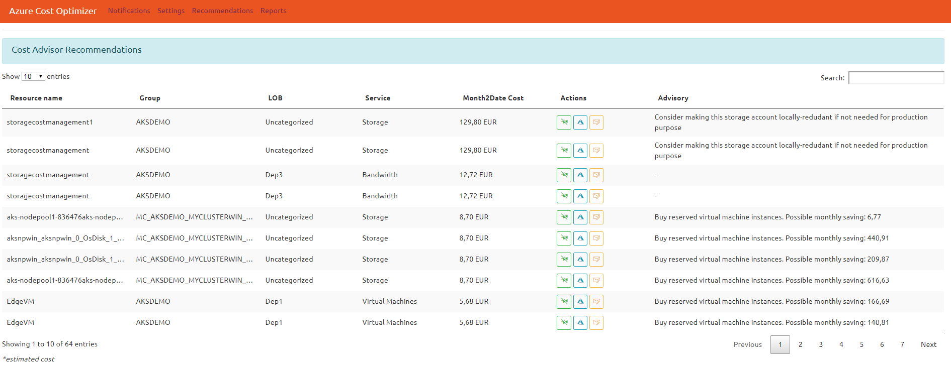
Recommendations
Dismiss Alert
Azure portal resource link
Notify Line Of Business owner
Efficiency recommendations

Slide 16
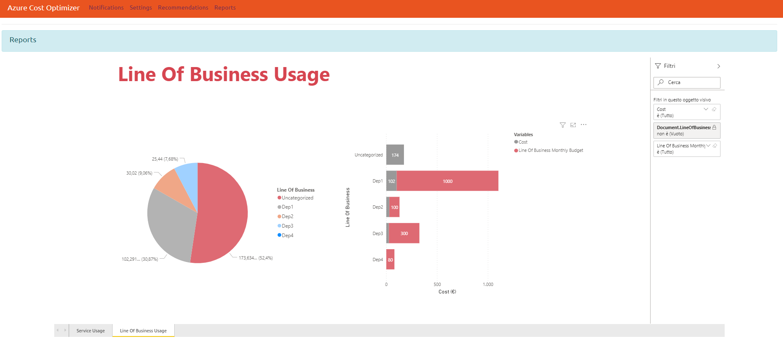
Reports
Customized Power BI Reports (.pbix)

